Slide 1


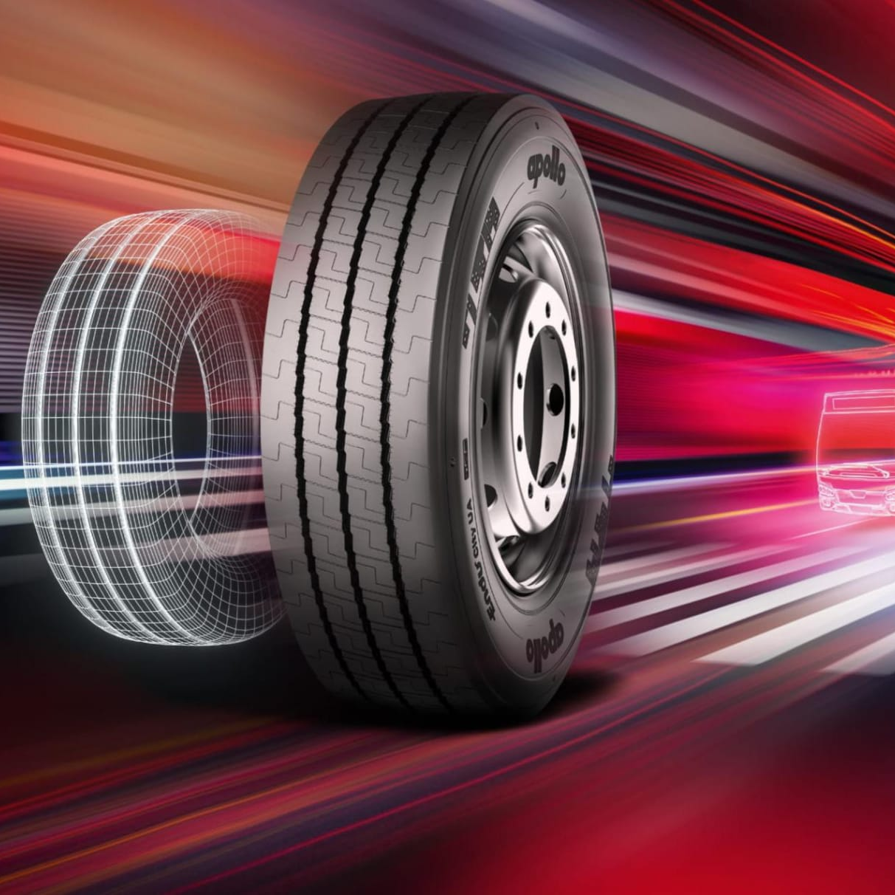
APOLLO TYRES
Team Members:
K.Praveen kumar
U.Keerthi
U.Nayva
T.Sudeep
G.Dinesh

Slide 2

Introduction
Apollo Tyres Limited is an Indian multinational tyre manufacturing company headquartered in Gurgaon, Haryana. It was incorporated in 1972, and its first plant was commissioned in Perambra in Chalakudy, Kerala. The company now has five manufacturing units in India, one in the Netherlands and one in Hungary It has a network of nearly 5,000 dealerships in India, of which over 2,500 are exclusive outlets.

Slide 3
History Apollo Tyres Ltd. came into inception in 1972 and has since been a trusted name in the business of manufacture and sale of tyres. With our corporate headquarters in Gurgaon, India, we cater to over a 100 countries across the globe. Our first plant was commissioned in Perambra, Thrissur, Kerala, India in 1975. In 2009, we acquired the Netherlands-based tyre maker Vredestein Banden B.V. which was later renamed as Apollo Vredestein B.V. Our manufacturing is spread over five facilities in India and one each in the Netherlands and Hungary.

Slide 4

Digital Marketing
Apollo Tyres was using various types of digital marketing strategies to promote their brand and products.
1.Social media marketing
2.Content marketing
3.Email marketing
4.Influencer marketing
5.Searching engine marketing and pay per click

Slide 5

Brand study Apollo Tyres is a well-established brand with a strong reputation for quality and performance. 1.Brand equity 2.Brand challenges 3.Strong product quality and performance 4. Innovative technology 5.Competitive pricing 6.Strong brand reputation 7.Customer satistifaction

Slide 6
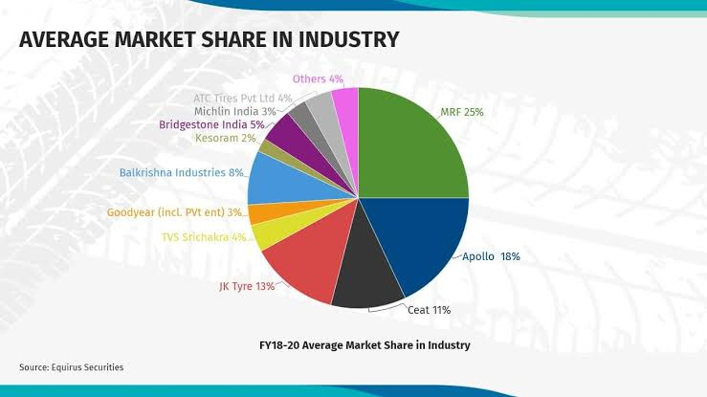
Competitors Analysis
Apollo Tyre
MRF Tyre
Ceat Tyre
JK Tyre
TVS Srichakra
Goodyear
Balkrishna Industries
Kesoram
Bridge stone india
Others

Slide 7

BUYER’S/AUDIENCE’S PERSONA 1.Budget-conscious consumers who value for money,durability,and longevity 2.Active,busy,and on-the-go individuals 3.Researches products online and in stores before making a purchases 4.prefers to buy from reputable brands

Slide 8

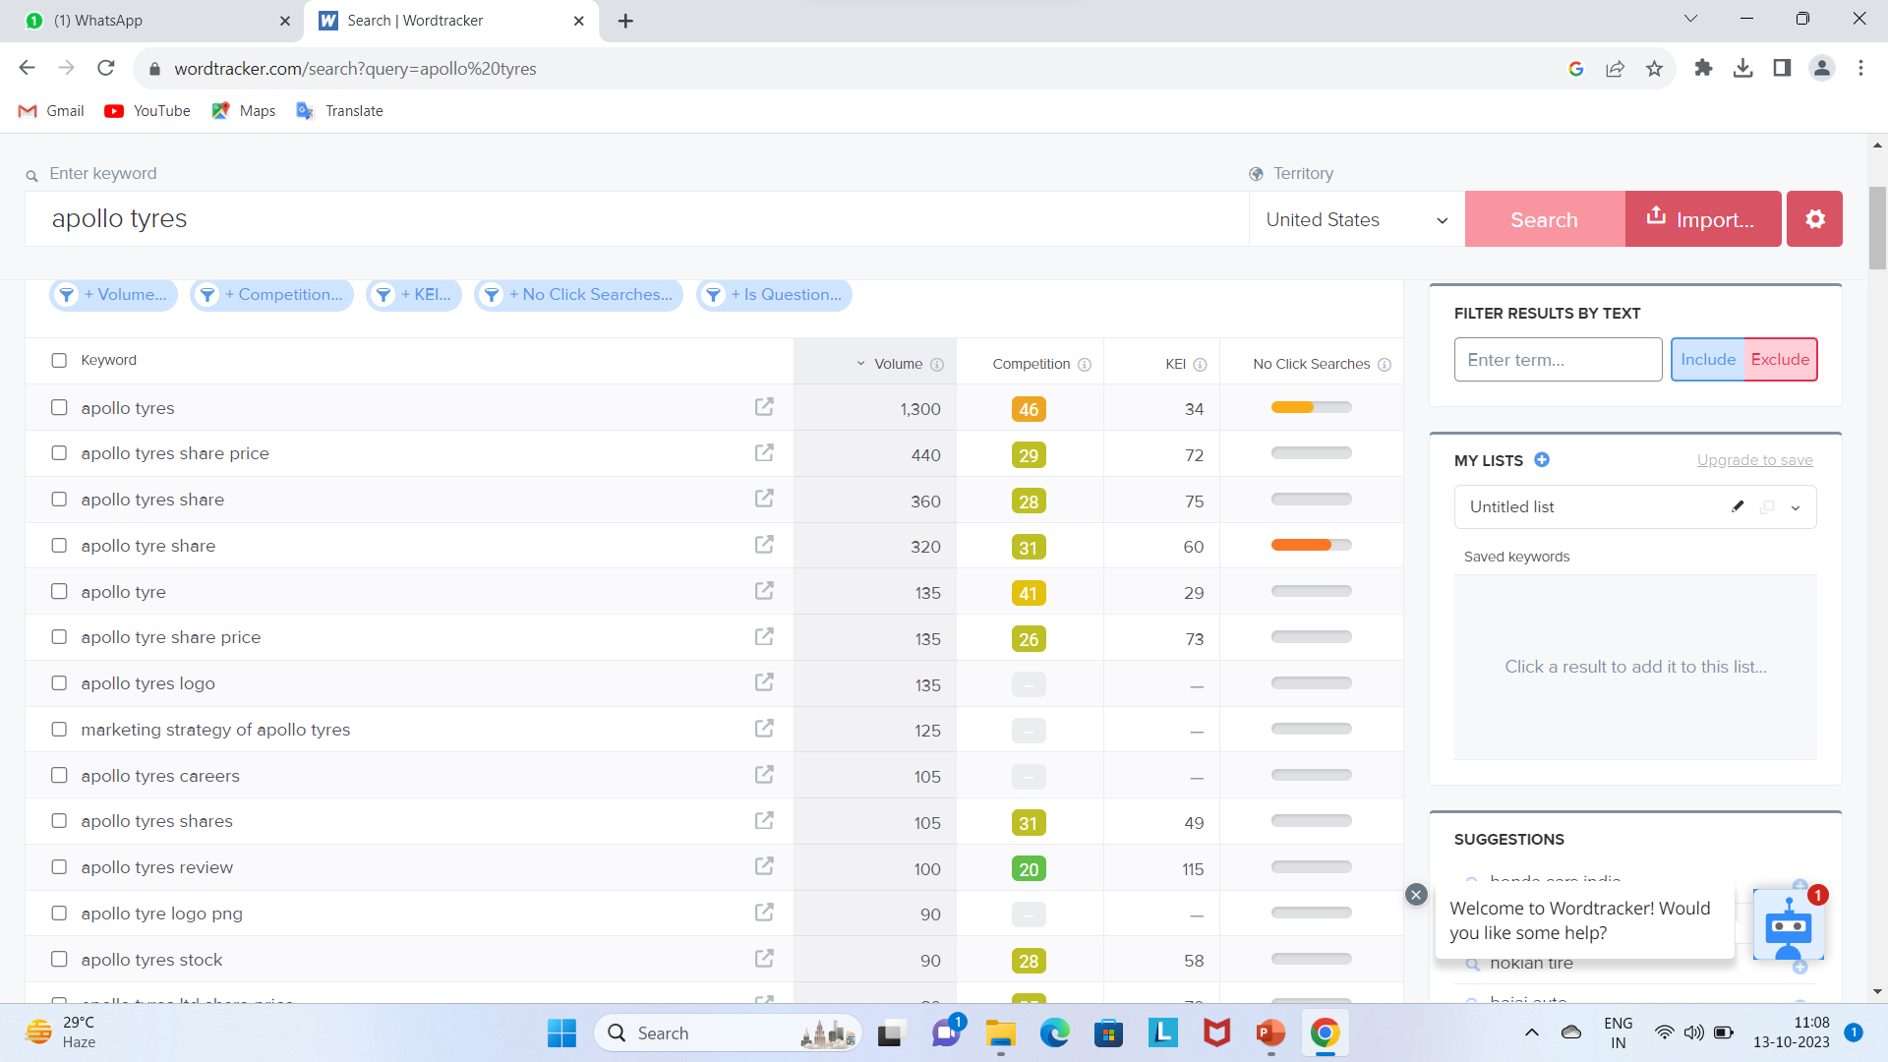
SEO &KEYWORD RESEARCH
SEO and keyword research are important for Apollo Tyres because they can help the company to reach its target audience and increase brand awareness.
Apollo Tyres Apollo Tyres price
Apollo Tyres review
Apollo Tyres India
Apollo Tyres car tyres
Apollo Tyres bike tyres
Apollo Tyres truck tyres

Slide 9

CONTENT IDEAS * How to choose the right tires for your vehicle * Tire safety tips * How to maintain your tires for optimal performance * New tire technologies and trends * Apollo Tyres product reviews and comparisons * Customer stories and testimonials

Slide 10

MARKETING STRATEGIES 1.Focus on your target audience and highlight your USP. 2.Use a variety of marketing channels to reach your target audience with engaging content. 3.Offer excellent customer service. 4.Partner with car manufacturers and dealerships, sponsor motorsport events, run social media contests and giveaways, offer referral programs, and get involved in your community.

Slide 11
CONTENT CREATION AND CURATION
Blog Posts
Articles
Videos
Infographics
Social media posts from other tire brands, industry experts and customers.
Customers stories and testimonials
Tyre safety tips
Behind the scenes photos and videos

Slide 12
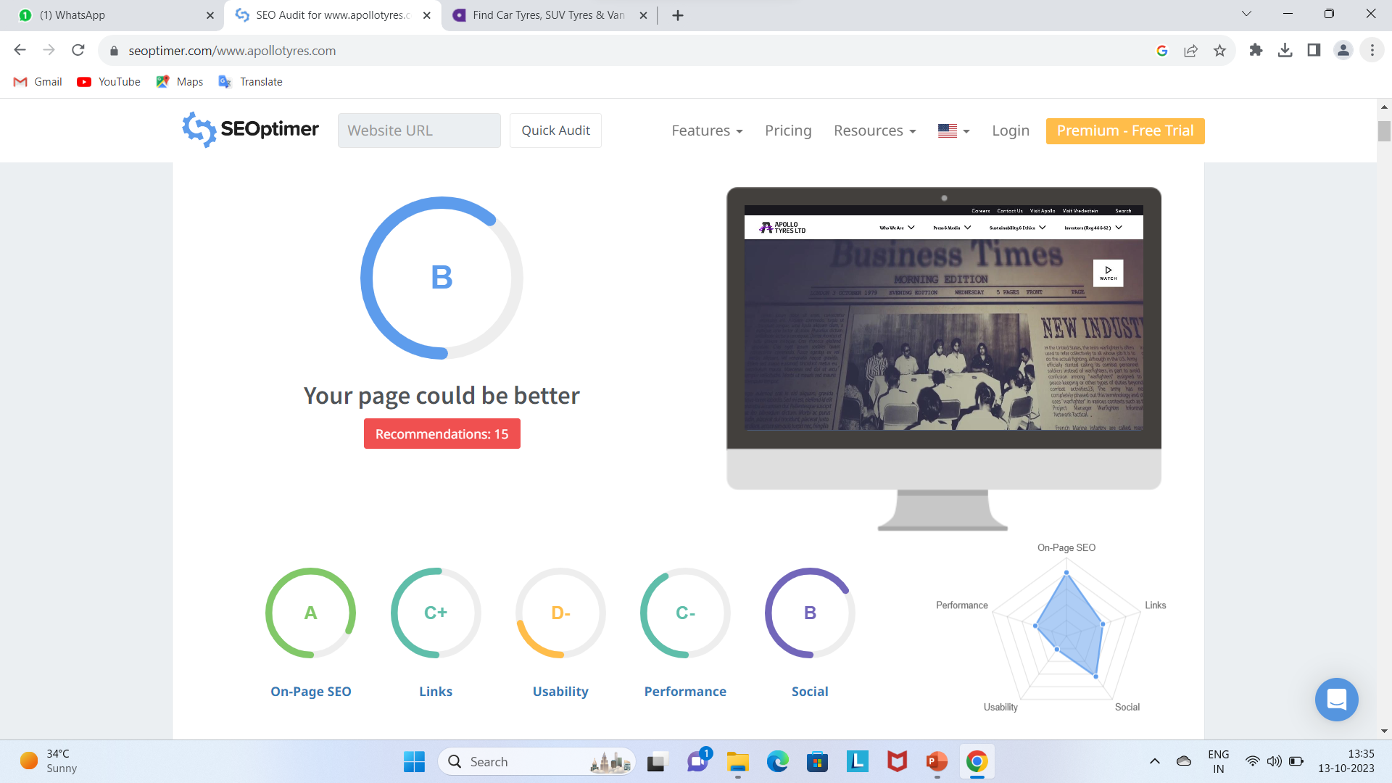
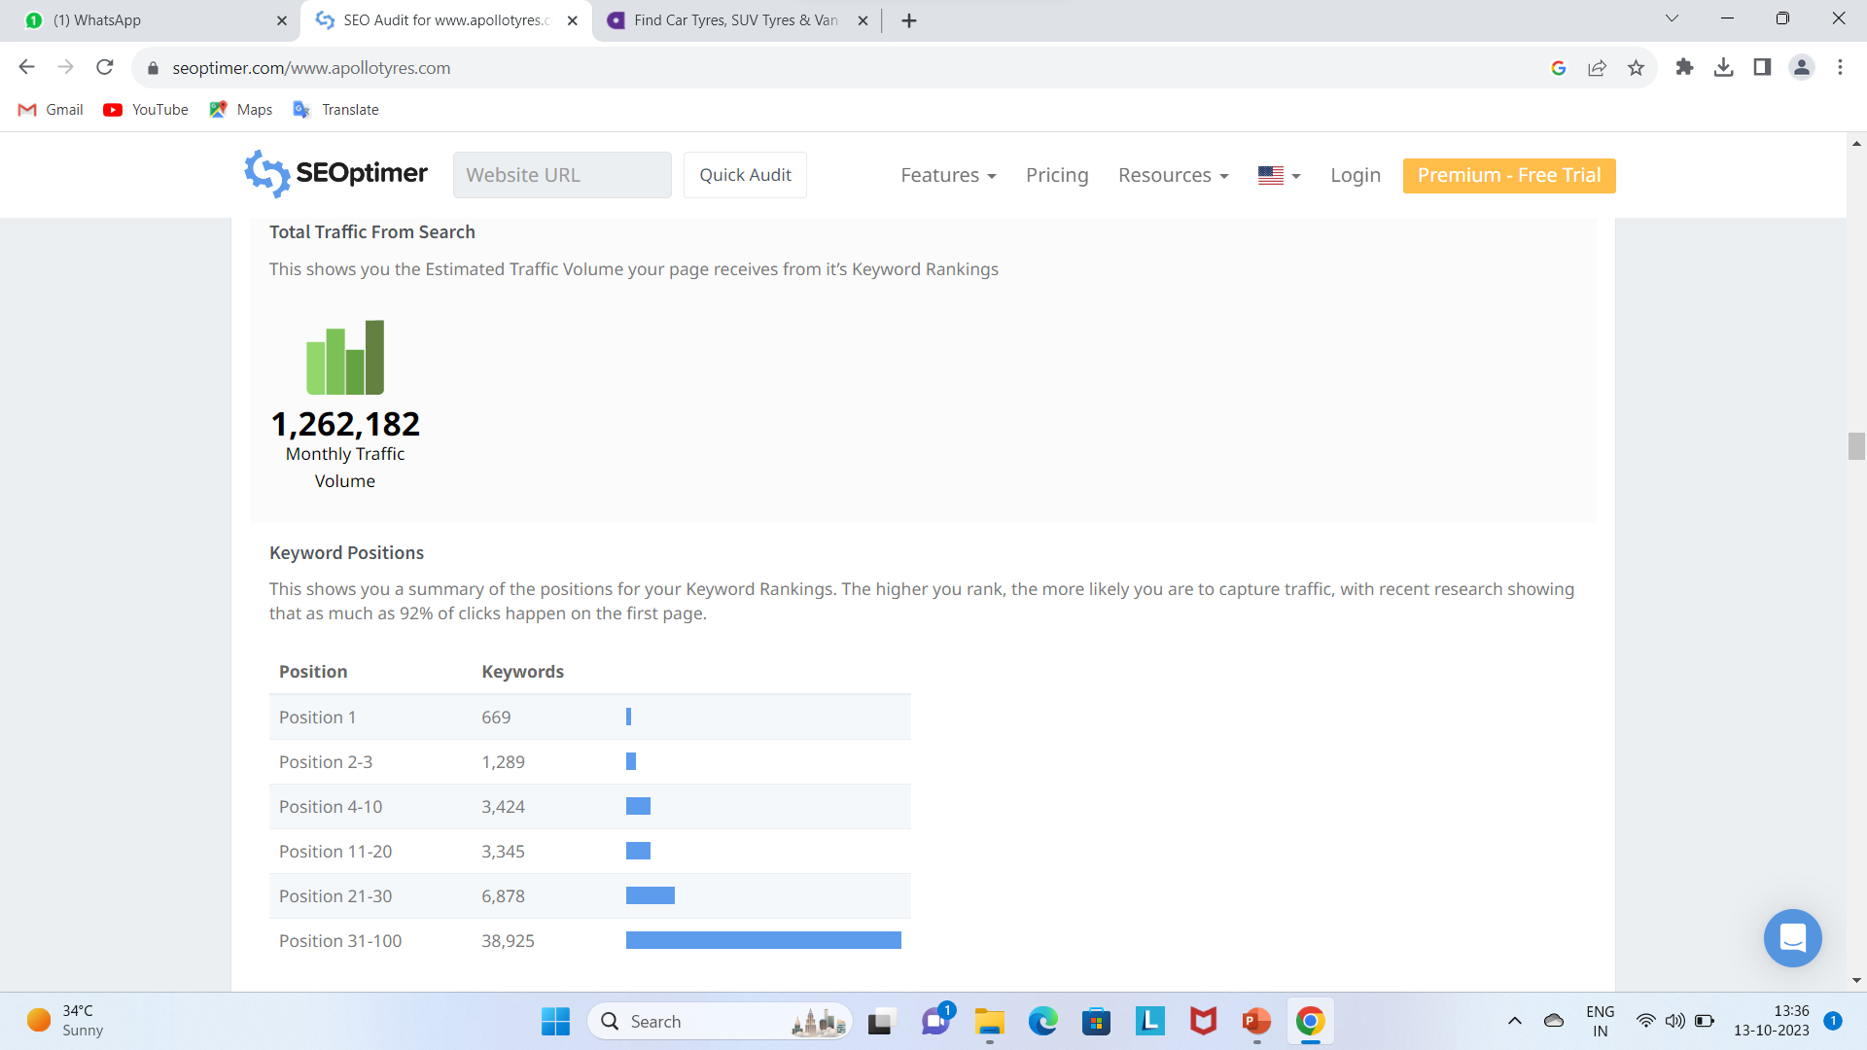
AUDIT REPORT

Slide 13
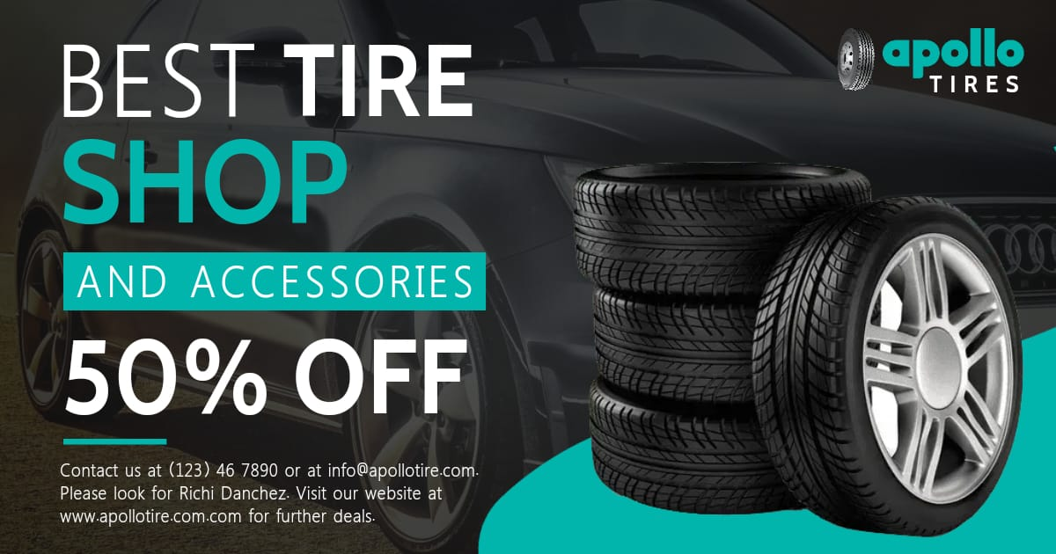
Poster Design

Slide 14

This is our brand promotion Reel click here
Instagram Reel

Slide 15

TEAM CONTRIBUTIONS
K.Praveen kumar (Team leader)
Brand research,competitor analysis and created Instagram reel
U.Keerthi
Poster deign,SEO and keyword research, digital marketing, PPT
U.Nayva
Buyers or audience persona, brand study
T.Sudeep
Content ideas,Marketing strategies
G.Dinesh
Content creation and curation

Slide 16

Thanks For Your Courtesy

